Slide 1

Knowledge Services Orientation for Division of Family Resources
Eligibility Assistants & Eligibility Specialists
2026

Slide 2

Table of Contents
Overview
Benefit Offerings
Time Worked and Compensation
Attendance Expectations
Office Conduct
Technology Guidelines
Additional Information
Growth Opportunities and Support
E-verify and FMLA

Slide 3
Overview
  EEO
  Point of Contact
  Employer
  Knowledge Services and DFR Partnership
  Employee Website

Slide 4
Knowledge Services Overview
Certified Woman-owned Business (WBE)
Founded in 1994
Headquartered in Indianapolis, IN
Service Offerings
  Consortium Management
  Survey Solutions
  Professional and Technical Business Solutions
  dotStaff
  Managed Service Provider (MSP) for Contract Labor

Slide 5
Equal Employment Opportunity
BCforward does not discriminate on the basis of:
  Race
  Color
  Religion
  Sex
  Sexual Orientation
  Pregnancy
  Marital Status
  National Origin
  Veteran Status
  Age
  Physical or Mental Disability
  Any other status that is unlawful by applicable Federal, State, and Local Laws

Slide 6

BCforward Overview
Knowledge Services works in partnership with BCforward, who serves as the Employer/Payroll provider for all EA and ES staff in your local office.
  Even though your Employer/Payroll provider will be BCforward, you will be recognized as Knowledge Services Staff.
DFR Management will direct the day-to-day operational activities for each Local Office EA/ES Employee.
Knowledge Services will be the central point of contact regarding all Employee Relations, performance related issues, time entry, etc.
BCforward will serve to address all matters regarding your payroll and benefit information.

Slide 7
Point of Contact
Your Knowledge Services Employee Relations Coordinator is your point of contact for the following reasons, but not limited to:
  Time Entry
  Policies
  Workplace Concerns
  Expenses
  PTO accrual
  Pay rate
  Call Off Procedures
  Any employee relations related questions

Slide 8
BCforward as your Employer
You are a BCforward employee for the duration of your assignment at this DFR office location.
Any and all issues, questions, concerns regarding your employment shall be directed to Knowledge Services on behalf of BCforward and not to your DFR SEM.
  i.e. pay, policies, performance, etc.
All recognition, performance, and/or employee issues will be addressed in collaboration with Knowledge Services and DFR on behalf of BCforward.

Slide 9
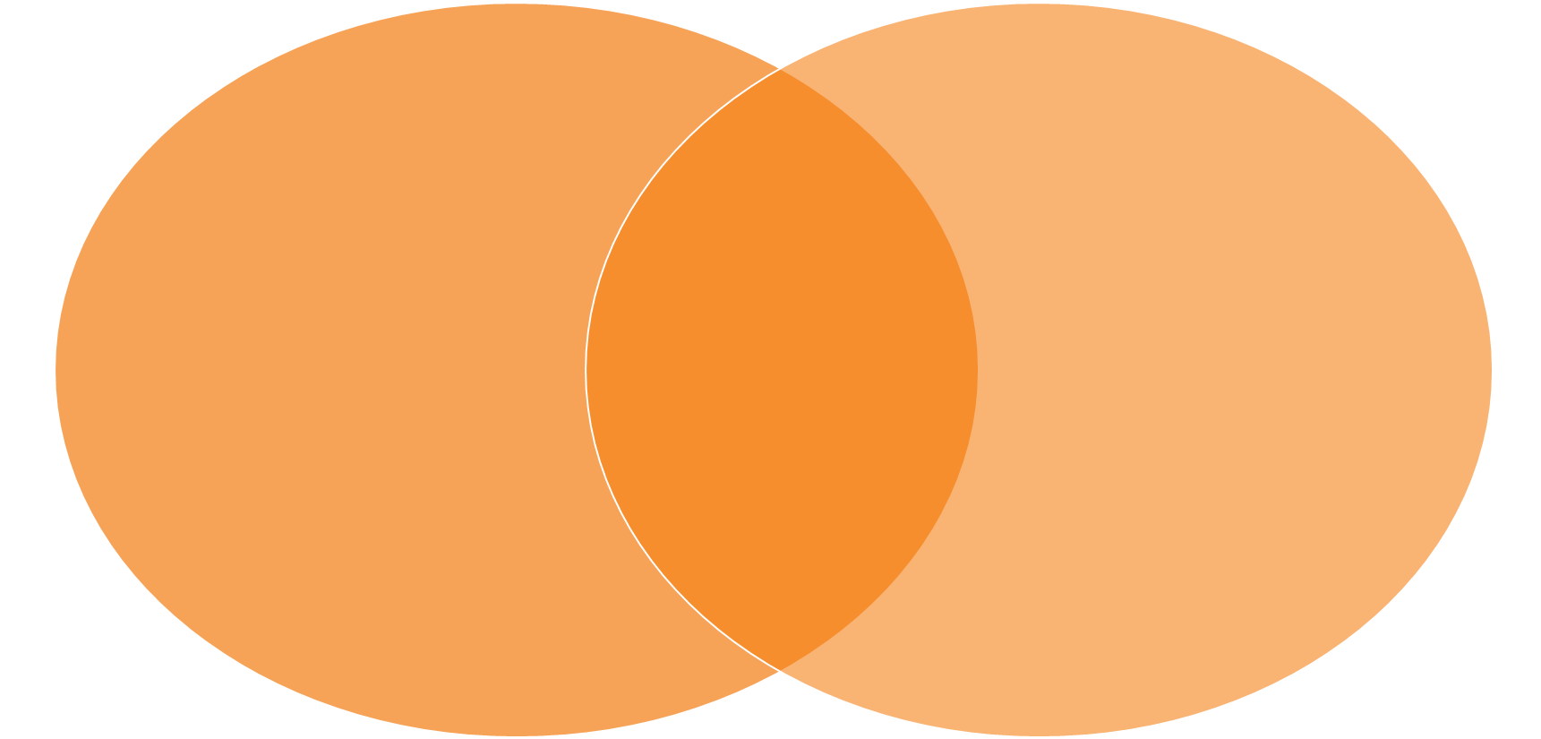
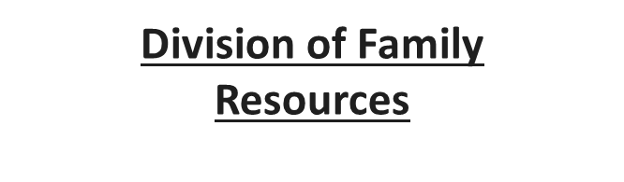
Knowledge Services & DFR Roles
Knowledge Services
Time off
Late/Early Arrival
Coaching Support
Career Growth
Support EA/ES Success
Onboarding & Offboarding
Performance Management
Employee Relations
All day-to-day Operations
Specific Job Duties
Weekly Time Approval

Slide 10
Knowledge Services, BCforward & DFR Roles
Knowledge Services’ Role
  Employee Relations Coordinator
  Performance Management
  Employee Onboarding and Off-boarding*
BCforward’s Role
  Payroll Processing
  Provides Benefits
  Employee Onboarding and Off-boarding*
DFR Manager’s Role
  Manage the day-to-day work product
  Approve/deny time submitted by employee
*Responsibility will be shared between KS and BCforward

Slide 11
Employee Website
In your Welcome Email that you received on your first day from your Point of Contact, you received a link to the Employee Website: https://programs.knowledgeservices.com/dfr/bcforward-employees-with-soin-dfr/
The Employee Website is an excellent tool for you to reference during your position, so please be sure to add it to your ‘Favorites’ by clicking the star icon on your tool bar.
This website provides the following:
  Time Entry guidelines and instructions
  Paid Time Off (PTO) Submission Form link
  Guides and Policies, including a copy of this orientation
  State Holiday Calendar
  Community Resources

Slide 12
Benefit Offerings
Holidays
Insurance
Paid Time Off
Bereavement Policy

Slide 13
Holidays
Paid holidays match the Indiana State Holiday calendar (7.5 hours per day).
If the week includes one of the paid holidays, you will receive 7.5 hours of holiday pay.
Knowledge Services will always be responsible for processing all paid holiday hours.
You should not enter any holiday pay into dotStaff.
You are not required to work the day before/after a holiday to receive holiday pay.
While on a Leave of Absence/Continuous FMLA you will not receive holiday pay.

Slide 14
Medical Insurance
Your medical insurance benefits are administered and provided by BCforward.
Please direct any questions regarding medical benefits to BCforward at 317.493.2019.

Slide 15
Paid Time Off
Your PTO Accrual Rate will be based upon your start date with DFR and will increase to the respective Accrual Rate on the anniversary of your start date.
PTO accrual is calculated by multiplying the PTO Accrual Rate by the total amount of hours worked each week.
  Example: The accrual rate is 0.0385. If the EA works a full week of 37.5 hours, then they will accrue 1.44 PTO hours for that week. 37.5 x 0.0385 = 1.44.
0-3 Years
Accrual Rate: .0385
Projected PTO in Days: 10
3 - 6 Years
Accrual Rate: .0577
Projected PTO in Days: 15
6 + Years
Accrual Rate: .077
Projected PTO in Days: 20

Slide 16
Bereavement Policy
The EA/ES will be granted a maximum of three (3) consecutive days off work following the death of an immediate family member. Such days shall be in conjunction with the time of the death or date of the funeral. Bereavement days are unpaid and do not count against their PTO balance, but staff may choose to use any accrued PTO.
  Relative means husband, wife, father, mother, son, daughter, brother, sister, grandparent (including greats), grandchild (including greats), or spouse of any of these, or a person living in the same household with the employee. For a married employee, these members of the spouse’s family are included.
As soon as possible, staff should send an email, copying both their DFR Manager and your Employee Relations Coordinator, noting the dates they will need to be out of the office for bereavement.
Documentation may be required.

Slide 17
Time Worked and Compensation
dotStaff Time Entry Process
Electronic Paycheck Statements

Slide 18
dotStaff™ Time Entry Process
dotStaff is the system used to enter your time worked each week.
In order to activate your new account, an Administrator or User at KS must first create it.
Once your account has been created, you should receive an email from “Admin” containing your Login Email as well as your Activation Code. You may not register without your unique Activation Code and Login Email.
  Navigate to my.dotStaff.com
  Select the Activate Account hyperlink.
  Complete the Activate Account Form in its entirety.
  Go to the Employee Site for full dotStaff ™ account activation instructions, as well as the dotStaff ™ Time Entry Guide.

Slide 19
Time Submittal - dotStaff™
Notify Knowledge Services if time was entered in dotStaff™ past the deadline each Monday at 10:00 a.m. EST
If you enter time that is not for the current payroll week, notify your Employee Relations Coordinator because this time is not automatically pulled for payroll.
Complete Timesheet
Checks are direct deposited on scheduled Fridays by BCforward
Payroll is processed based on your approved timesheet.
Submit Time for Approval by Monday 10 AM EST
If timesheet is denied by manager, it is employee’s responsibility to correct

Slide 20
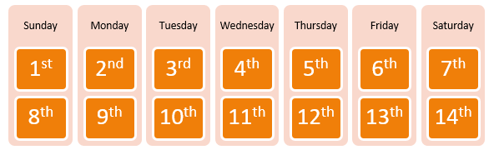
Time and Pay
Time is due in dotStaff™ by 10:00 a.m. EST on Mondays.
  You are expected to report all actual hours worked- no more and no less- for each day worked.
  Any time entered late must be brought to your Employee Relations Coordinator’s attention.
  Late time entry can delay the processing of your pay.
  Your Employee Relations Coordinator will communicate any deadline changes due to banking holidays.
Paychecks are issued every Friday by BCforward.
  For example, you submit time for the week of the 1st by Monday at 10:00am EST on the 9th, you receive your direct deposit on the 13th or your check is mailed on the 12th.
  Please Note: If you are set up for direct deposit, the funds will be available in your account by noon each Friday. If you are to receive a live check, those are mailed via USPS each Thursday.

Slide 21
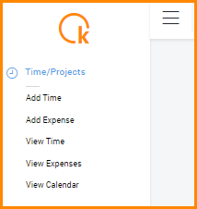
How to Add a Timesheet in dotStaff™
Go to “Time/Projects”
Click “Add Time”

Slide 22
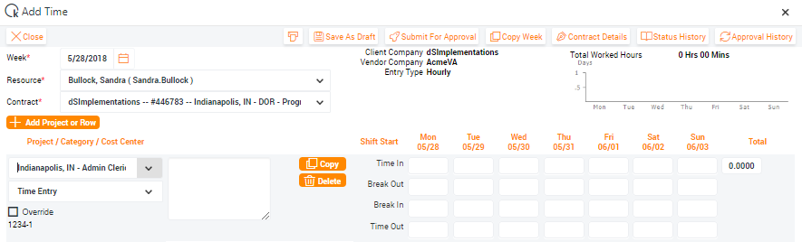
Blank Timesheet
Easily enter your shift times
Time In → Break Out
Break In → Time Out
You will have the option to either:
Save time as a draft
Submit for approval.
Only submit Regular Hours – KS submits “PTO Hours” and “Holiday Hours”

Slide 23
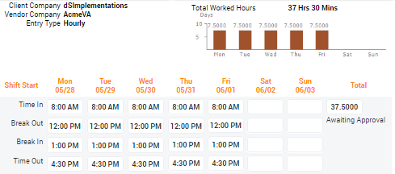
Time Entered
You will see awaiting approval once time is submitted for the week.
As you successfully submit your time, a bar graph will appear with daily hours entered.

Slide 24
Expenses - Travel
If you have approval from your DFR Manager to submit expenses for travel (i.e. training, office coverage), notify your Employee Relations Coordinator prior to the date of travel.
Your Employee Relations Coordinator will provide you expense submittal instructions.

Slide 25
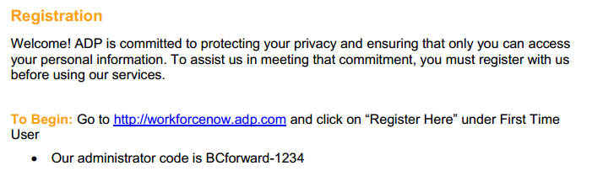
Electronic Paycheck Statement Info
After you receive your first paycheck, you will be able to access your paystubs online through BCForward ADP log-in.
You will be responsible for registering your account.
Complete Registration Instructions are available on the Employee Website.

Slide 26
Attendance Expectations
  Attendance
Training Attendance Policy
Paid Time Off Use
Time off Requests
PTO Submission – How-To
  Call Off Procedure

Slide 27
Attendance
You will be able to work 37.5 hours per week, 7.5 hours each day.
  All FSSA offices are open for business Monday through Friday from 8:00 a.m. to 4:30 p.m.
  Information on break and lunch times will be provided by your DFR local office manager.
  Any adjustment to your normal work schedule (i.e. shortened lunch, late arrival, etc.) requires prior approval from your DFR local office manager and your Employee Relations Coordinator.
You are responsible for maintaining excellent attendance, which means:
  Reporting to work on time as scheduled
  Returning from breaks and lunch on time
  Working until the end of the scheduled workday
  Requesting time off in advance

Slide 28
Attendance Continued
All absences must be pre-approved by your DFR Manager and Employee Relations Coordinator.
Send any doctors’ notes, court/jury duty statements, and any other form of documentation to your Employee Relations Coordinator only.
Reoccurring absences and tardiness will result in warnings up to and including termination.
Three days of no call, no show will be considered job abandonment and a voluntary resignation.
One day of no call, no show may be subject to termination.
For types of leaves of absences please contact BCforward.

Slide 29
Training Attendance Policy
Attendance in Training is crucial to the overall success of the individual.
The expectation is that trainees are present for the entire length of training.
The following guidelines are established to ensure trainees are able to successfully complete training and meet/exceed quality and tasks per hour (TPH) expectations in production
  For training classes greater than 8 weeks, the trainee cannot miss more than 24 hours (3 days) of training.
  For training classes ranging approximately 2 to 3 weeks, the trainee cannot miss more than 8 hours (1 day) of training.
Special consideration may be granted based on extenuating circumstances as agreed on by the DFR Manager and the Training Manager.

Slide 30
Paid Time Off Use
Employees are REQUIRED to utilize PTO for any time off work - which may include vacation, illness, personal business, etc.
As a general guideline, unpaid time off should only be used for emergencies or prior approved absences, in the event PTO is unavailable.
Unauthorized leave may be subject to disciplinary action.
You start accruing PTO hours on your start date on the DFR project.
PTO is calculated at an accrual rate based upon every hour worked.
If an employee ends their assignment with PTO in their balance, these hours will be paid out on separate check the week following their final check. This payout is not to exceed 40 hours.
To utilize accrued PTO, a PTO Submission Form must be completed.

Slide 31
Time Off Request Process
Employee requests time off via email to DFR Management and KS
DFR Manager responds to email and provides recommendation based upon operational need
KS approves/denies time off request and informs Employee and Manager via email
If approved, Employee submits online time off form to KS
Employee takes time off
Remember to request, not tell:
Can I have 5/24 off for a medical procedure?
instead of
I will not be in on 5/24.
KS Employee
DFR Manager
KS Program Team
Complete Time Off Policy can be found on the Employee Website:
https://programs.knowledgeservices.com/docs/dfr/DFR_Time_Off_Policy.pdf

Slide 32
PTO Submission Form
If the time off request has been approved by both KS and DFR Management, you will then complete a PTO Submission Form.
The PTO Submission Form is available on the employee site.
PTO Submission Forms are due by 10:00 AM EST on Mondays for the prior week.
  If the PTO Submission Form is submitted past the deadline, then the PTO hours will not be processed until the following pay period.
You will receive a confirmation email when you submit the form.
If PTO Submission Form is not submitted in a timely manner your Employee Relations Coordinator will submit the form on your behalf. PTO must be used for any time off for vacation, illness or personal business.

Slide 33
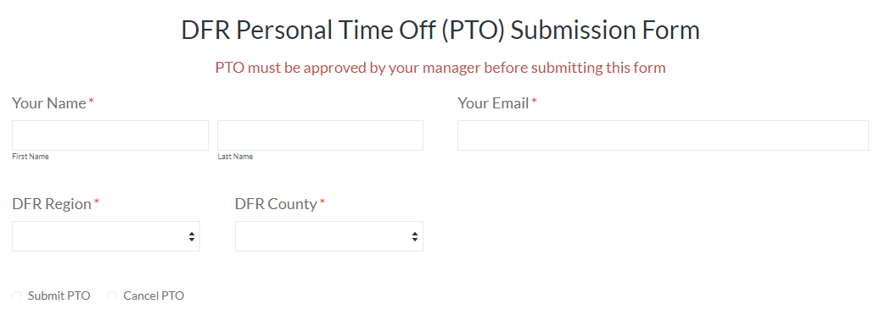
PTO Submission Form
Enter your first and last name
Enter your email address
Select your region
Select your county
Select to submit or cancel PTO

Slide 34
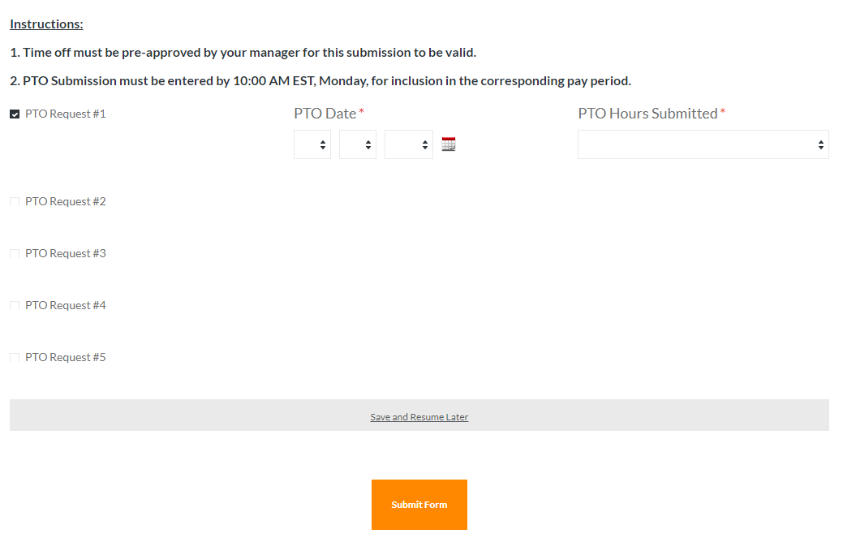
PTO Submission Form
Select the number of days you are requesting
Select date
Select the amount of PTO (must be in increments of 15 minutes)

Slide 35
Call Off Procedure
In the event that illness, inclement weather, or emergency prevent you from reporting to the DFR office at your scheduled time, please follow the proper call off procedure for your office.
If you are going to be arriving after 8:00 AM, or if you are not coming in at all, you must contact the following people prior to 7:45 AM:
  Your Local Office DFR Managers – Make sure you have your SEM’s phone numbers saved in your phone and contact them via their preferred method.
  Knowledge Services – You should notify your Knowledge Services Employee Relations Coordinator by phone call or email. Text messages are unable to be received.
We recommend that you save the contact number for your DFR manager and your KS Employee Relations Coordinator in your phone within your first week.

Slide 36
Office Conduct
  Professionalism and Customer Service
  Dress Code and Professional Attire
  Office Etiquette
  Confidentiality
  Harassment
  Alcohol and Drug Free Workplace

Slide 37
Standards of Performance and Conduct
We have established workplace standards of performance and conduct as a means of maintaining a productive and cohesive working environment.
Any performance issues or policy violations could result in disciplinary action up to and including immediate discharge.
Employees will be required to complete and pass knowledge training tests (Gateways) during EA and ES training.

Slide 38
Professionalism and Customer Service
Knowledge Services employees are expected to be professional and treat every client with respect.
A goal of the Eligibility Assistant and Eligibility Specialist position is to provide a welcoming and respectful environment to all clients seeking assistance.
Please maintain a positive and respectful attitude in all interactions with clients and coworkers while at the DFR office.
Employees are also expected to work cooperatively with coworkers to meet the needs of all clients.
Personal matters and private client information should not be discussed at the front desk within the hearing range of clients in the office or on the phone.
Inappropriate comments and profane language are also not tolerated in the workplace, especially toward clients or in front of them.
Please do not accept monetary or other forms of gifts from Clients or guests in the DFR office.

Slide 39








Dress Code and Professional Attire
Eligibility Assistant and Eligibility Specialist Dress Code is business casual.
Your attire and grooming are to be neat, clean and appropriate for your work situation as determined by your DFR Local Office Manager.
If you have questions or concerns about the dress code, you are encouraged to contact your DFR Manager.

Slide 40
Office Etiquette
Reserve break activities for designated break times and areas.
  Your cell phone should be put away at all times and only be used during break times and in designated break areas.
  Food is not permitted at your desk area.
  Focus should be on assisting the clients and not socializing with your coworkers
If you are in the phone queue, you are expected to answer incoming calls in a timely manner, stepping away only when needed and during break times, and updating your phone status accordingly.
Ensure that you are following all directives from management and that you are willing to complete any additional job duties as assigned.
You are responsible for your performance and your job duties.
You are expected to remain awake, alert and attentive during business hours.

Slide 41
Confidentiality
You will be in contact with personal, private and confidential client information as a routine part of your job duties. Confidential Information includes, but is not limited to, personal information such as:
  Date of Birth
  Social Security Number
  Identification Cards
  Individual Health Information
You will receive training and additional important information from DFR/FSSA on the importance of maintaining confidentiality and upholding the security of information, as well as your obligations under the Health Insurance Portability and Accountability Act (HIPAA), state and federal law, and other relevant FSSA and DFR regulations and policies regarding the safeguarding of confidential information.
You are to abide by such policies and procedures and acknowledge that you may be subject to disciplinary action in the event of any violation of the above.

Slide 42
Sexual Harassment
Unwanted sexual advances
Offering benefits in exchange for sexual favors
Making or threatening reprisals after a negative response to sexual advances
Visual conduct: leering, making sexual gestures, displaying of sexually suggestive objects or pictures, cartoons or posters
Verbal conduct: making or using derogatory sexual comments, epithets, slurs, and jokes
Verbal sexual advances or propositions
Verbal abuse of sexual nature, graphic verbal commentaries about an individual’s body, sexually degrading words used to describe an individual, suggestive or obscene letters, notes or invitations
Physical conduct: touching, groping, assaulting, impeding or blocking movements

Slide 43
Other Forms of Harassment
If you witness or experience any form of harassment:
No harassment is tolerated.
Other forms of harassment include:
Racial or Ethnic Harassment
  Slurs, jokes, or other verbal or physical conduct relating to an individual’s race, national origin or ancestry
Religious Creed
Physical Disability
Medical Condition
Marital Status
Age
Report harassment to Knowledge Services
Investigation is conducted
Further action determined by KS in partnership with DFR
Retaliation is prohibited.

Slide 44
Alcohol & Drug Free Workplace
Actionable offenses:
  Employees, agents, contractors, vendors and visitors are prohibited from the unlawful manufacture, distribution, dispensation, possession or use of alcohol and/or controlled substances on Knowledge Services’ or clients’ or leased property.
  No one shall report to work under the influence of alcohol and/or illegal drugs.
  Unlawful substances are not to be stored in a vehicle on Knowledge Services’ or our clients’ or leased premises.

Slide 45
Technology Guidelines
  Internet and Telephone Code of Conduct
  IRUA
  Social Media Policy

Slide 46
Internet and Telephone Code of Conduct
Computer equipment as well as all other client or Knowledge Services equipment is to be used strictly for company related business.
Systems are intended solely for business use. Personal or improper use of these systems may result in disciplinary action.
Reviewing confidential information in the state systems for your own personal use and information is prohibited.
Accessing the Public Assistance cases of friends and family members is prohibited.
If you do not have a business reason to be in a client’s case, you should not be in their case.
Abuse of your telephone privilege may result in disciplinary action.
Taking photographs in the DFR office is strictly prohibited due to confidentiality.

Slide 47
Information Resources Use Agreement (IRUA)
The IRUA is the Information Resources Use Agreement that you signed when you started your position with the DFR and applies to the appropriate use of state hardware, software, data, information, network, personal computing devices, phones and other information technology.
Examples of violations could include the following:
  Improperly creating public assistance (PA) cases is a direct violation of state policies and procedures (PA applications are to be created by the clients on computers provider at DFR)
  Submitting a false statement into a PA is a criminal violation of Indiana Criminal Code 35-43-5-7, which is welfare fraud - Improperly accessing PA cases and/or the use or disclosure of such information is a breach of the Health Insurance Portability and Accountability Act (HIPAA). Protected health information (PHI) under HIPAA includes any individually identifiable health information. Identifiable refers not only to data that is explicitly linked to a particular individual. It also includes health information with data items which reasonably could be expected to allow identification of an individual.
If you have a case or are an authorized representative for someone with a case, always work through the RCC for any assistance. If you need support from a local office, please work directly with a SEM and never with a coworker in your office.

Slide 48
Social Media Policy
Refrain from posting on social media about your job. As an EA or ES, you are a representative of Knowledge Services and DFR at all times.
All data and information entered, received, or stored on company equipment is the property of the agency and there should be no expectation of privacy.
Access social media only on personal devices and only during breaks or lunch.
Do not use your agency email address for personal social networking accounts.
Stop and think before posting. If you feel a post crosses into questionable territory, we encourage you to refrain from posting that information.

Slide 49
Additional Information
  Workplace Safety
  Workplace Injury
  Employment Earnings and Verifications
  Information Updates

Slide 50
Workplace Safety
Our primary concern is the health and safety of our employees.
Report all safety concerns or unsafe work conditions to your Employee Relations Coordinator immediately.
Read and follow the safety standards outlined in the Knowledge Services Employee Handbook.

Slide 51
Workplace Injury
You are required to contact BCforward at:
317.493.2019
to report an injury as soon as possible along with your KS Employee Relations Coordinator.
In an emergency – Dial 911

Slide 52
Employment Earnings and Verifications
Contact BCforward for any Employment Verification Forms to be completed by employer.
If you need employment verification on letterhead, email BCforward with the specific information that you need.
  HR@bcforward.com
  Phone Number: (844) 471-2255

Slide 53
Information Updates
Advise Knowledge Services and BCforward of any of the following changes:
  Name
  Address
  Phone Number: Work and Personal
  Email Address: Work and Personal
  Manager
  Marital Status
  Number of Dependents
  Individual(s) to Notify in Case of Emergency
  Beneficiary Designations
Changes must be made in writing (email or fax)
Notification of these changes must be made within 30 days of occurrence

Slide 54
Growth Opportunities and Support
  Growth Opportunites
  Office Visits
  QA and TPR
  EA Working Lead and ES Working Lead Support
  Contact Information

Slide 55
Growth Opportunity
Your career with Knowledge Services at the Division of Family Resources provides you with the excellent opportunity for upward mobility within the organization.
It is our goal to help provide growth opportunities to you to advance your career with Knowledge Services at the DFR office.
If you are interested in advancement, we encourage you to let your DFR manager know about your interest and to see if there are any steps that you can take now.
Eligibility Assistant
Eligibility Specialist
State Eligibility Consultant

Slide 56
Follow-Up and Office Visits
Your Employee Relations Coordinator will contact you regularly to check in for concerns or questions and will make visits to your local office throughout the year.

Slide 57
EA and ES Working Leads
- Who are they?
  Liaison between the DFR, EA/ESs and Knowledge Services
- What do they do?
  Visit offices
  Assist with training, mentoring, orienting
  Help facilitate communication
- What are they not?
  Supervisory
  Human Resources
Working Leads
DFR Management
Knowledge Services
EA and ES

Slide 58
Third-Party Reviews (TPR)
Knowledge Services has a Third-Party Review program that is dedicated to reviewing the work of trained Eligibility Specialists.
Third-Party Reviews (TPRs) begin 60 days after the successful completion of new hire ES Training.
A minimum of two (2) TPRs will be performed and coached each month by the Peer Review Working Leads.
Third-Party Reviews are designed to equip ES staff with the tools and resources for continued growth in their position.
Team Email Addresses:
DFRQA@knowledgeservices.com

Slide 59
Contact Information
  Please contact your Employee Relations Coordinator if you need any assistance.
  If your Employee Relations Coordinator is out of the office and you have an immediate need you can email KSDFR@KnowledgeServices.com
  Bcforward Point of Contact
    Emily Edgemon emily.edgemon@bcforward.com
We look forward to working with you!
Please know we are here
to answer any questions.

Slide 60
FMLA and E-Verify
  FMLA
  E-Verify

Slide 61


E-Verify – USCIS Employment Eligibility Verification
In accordance with federal regulation, the following information is available for all employees to review.
E-Verify Poster – Notice to Employee (left)
Right to Work Poster – Department of Justice (right)

Slide 62

E-Verify – USCIS Employment Eligibility Verification
In accordance with federal regulation, the following information is available for all employees to review.
E-Verify Poster – Notice to Employee (left)
Right to Work Poster – Department of Justice (right)

Slide 63
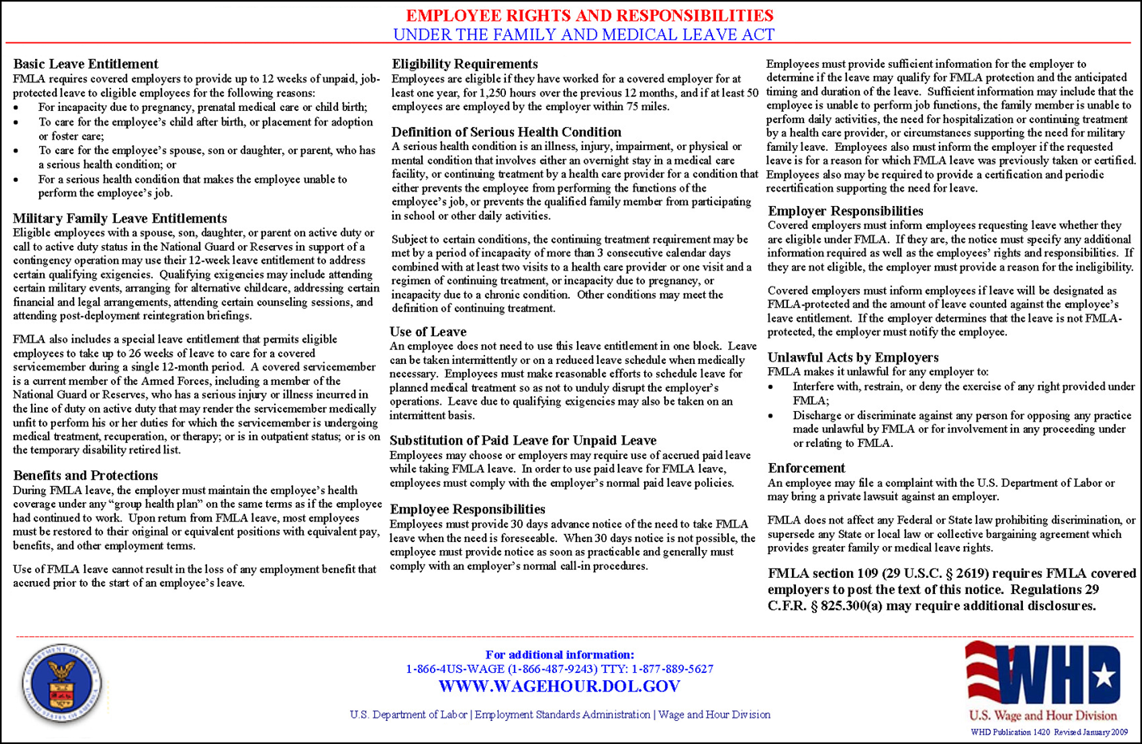
Family and Medical Leave Act

Slide 64

Family and Medical Leave Act
Knowledge Services, in partnership with the DFR, will provide reasonable accommodations regarding Leave of Absences.
Family and Medical Leave Act (FMLA)
Eligible employees are those who have been employed by the Company for at least 12 months (not necessarily consecutive), have worked at least 1,250 hours during the 12 months immediately prior to the family and medical leave of absence may request FMLA.
A family and medical leave may be taken for the following reasons:
  The birth of an employee’s child or the placement of a child with the employee for foster care or adoption, so long as the leave is completed within 12 months of the birth or placement of the child
  The care of the employee’s spouse, child or parent with a “serious health condition”
  The “serious health condition” of the employee
Leave of Absence (LOA)
In the event an employee does not meet minimum eligibility requirements for FMLA, LOA may be approved by the DFR, in its discretion, outside of the standard FMLA coverage.
When approved by DFR, in its sole discretion, an employee’s position may be held open, for a reasonable amount of time, until employee is able to return to the office.

